Slide 1
theory guided data science (…and how to make a presentation using google image search …)

Slide 2
current data science models
the big idea

Slide 3
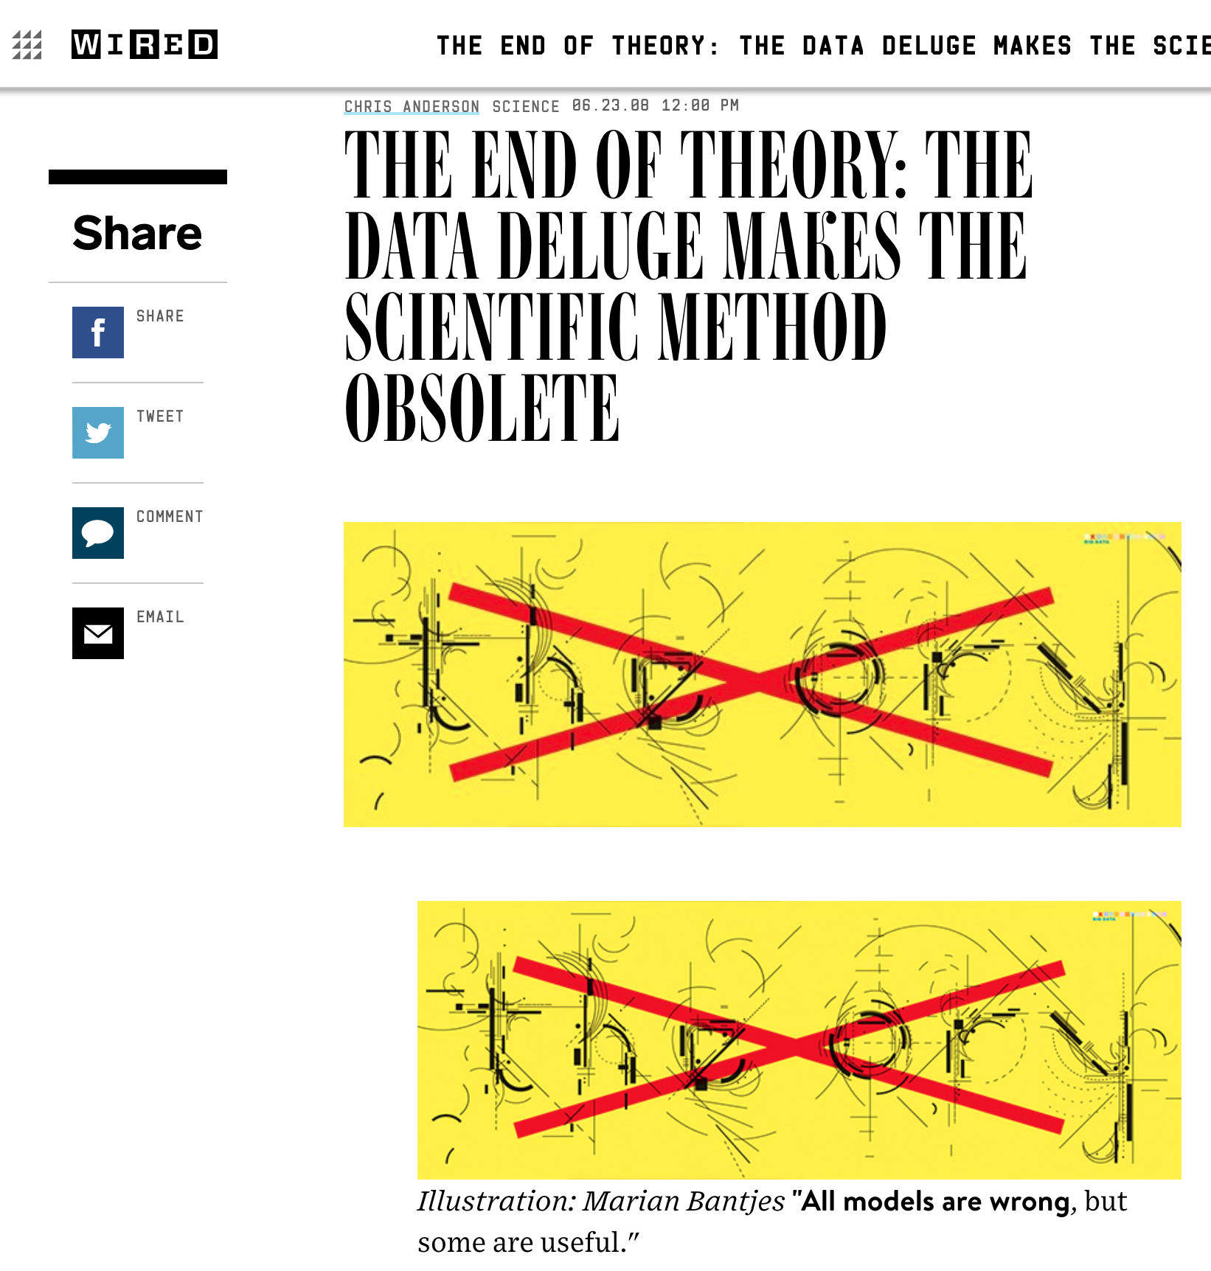
this has not happened!

Slide 4
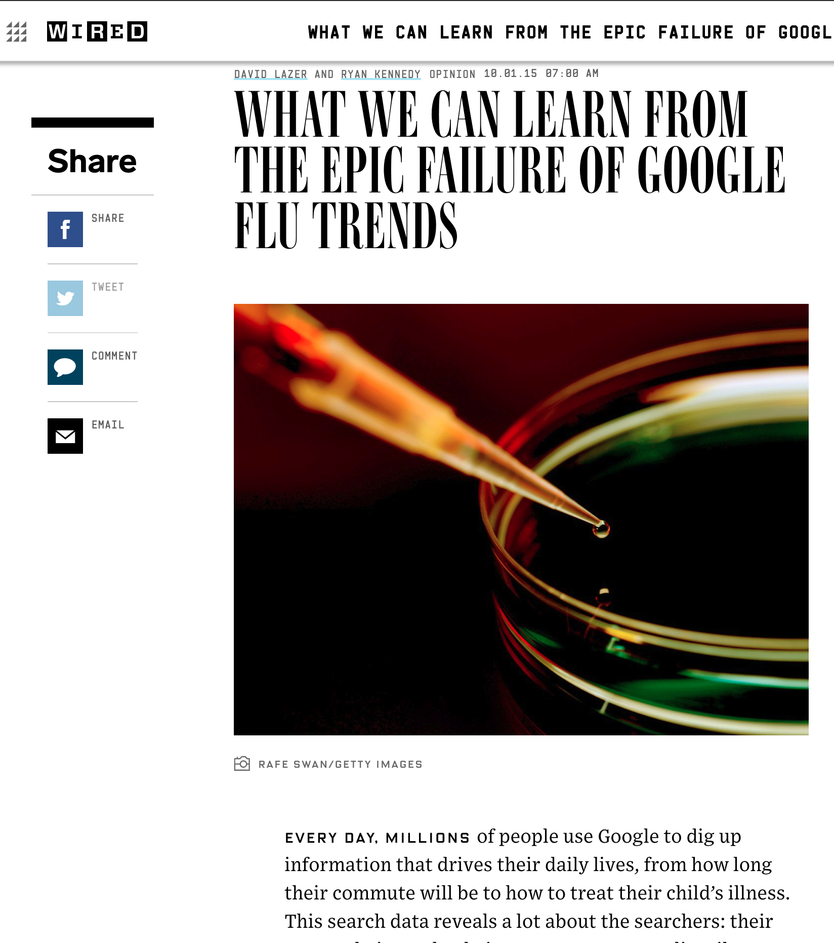
google flu trends – promising start – bad forecasts

Slide 5
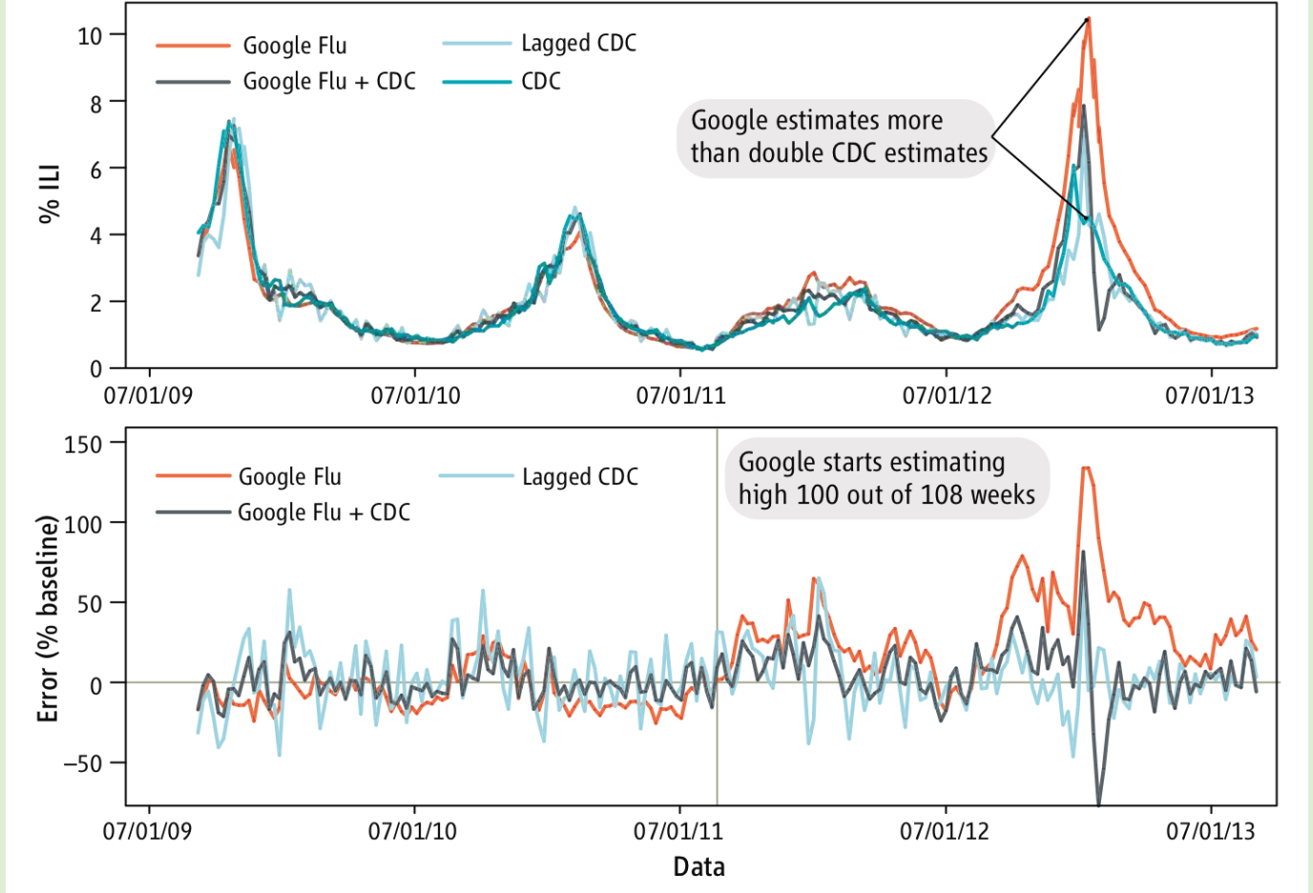

Slide 6
physical relationships are complex
limited data available
models not representative
spurious validation

Slide 7
motivating example
why is this important?
why is this hard?
scientists know how to model surface flow
- sound theory
not so much for subsurface flow
- weak physics equations
hard to get data
- challenging to build accurate data-driven models

Slide 8
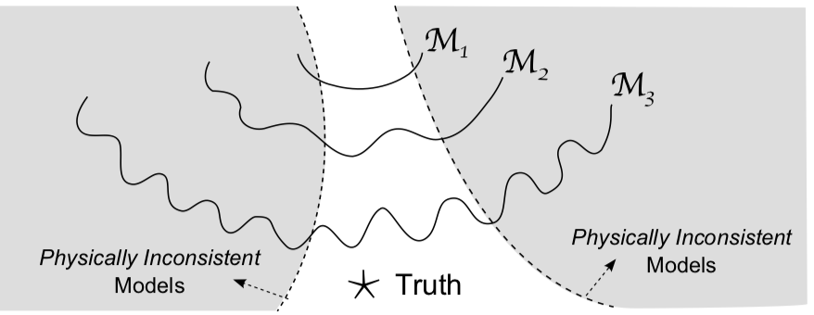
data driven models with limited data
- use scientific knowledge to influence the training
coming back to the big idea
ensure
1. accuracy (on training data)
2. simplicity, and
3. consistency (according to scientific knowledge)

Slide 9
1. choice of model families
2. learning constraints
3. output refinement
4. hybrid models
5. augment theory with data

Slide 10
1. theory guided model choice

Slide 11
1. theory guided model choice
choosing RNN over CNN
models for sub-processes

Slide 12
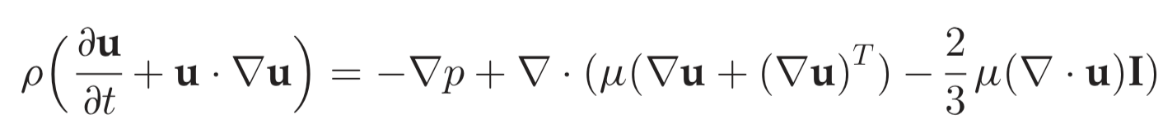
initialization – neural networks
priors – probabilistic models
constraints
could be challenging
regularization
2. theory guided learning
Physics constrained nonlinear regression models for time series

Slide 13
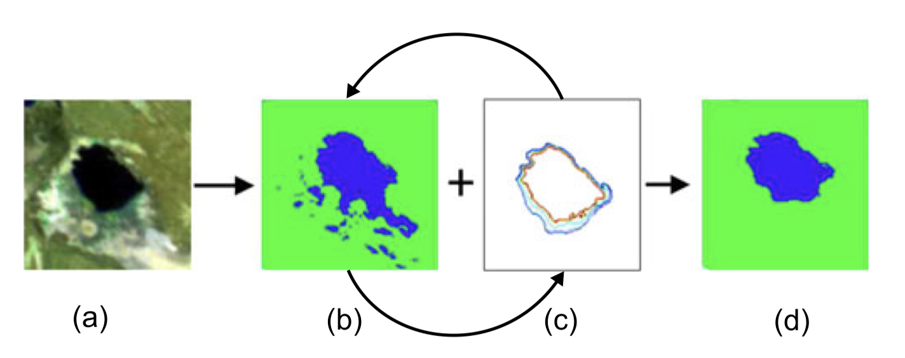
3. theory guided refinement

Slide 14
4. hybrid models

Slide 15
5. augmenting theory based on data

